Slide 1
UNIT-II
CONTROLLED ACCESS

Slide 2
12-2 CONTROLLED ACCESS
In controlled access, the stations consult one another to find which station has the right to send. A station cannot send unless it has been authorized by other stations. We discuss three popular controlled-access methods.
Topics discussed in this section:
Reservation Polling Token Passing

Slide 3
Reservation :
In the reservation method, a station needs to make a reservation before sending data.
Time is divided into intervals. In each interval, a reservation frame precedes the data frames sent in that interval.
If there are N stations in the system, there are exactly N reservation mini slots in the reservation frame.
Each mini slot belongs to a station. When a station needs to send a data frame, it makes a reservation in its own mini slot.
The stations that have made reservations can send their data frames after the reservation frame.

Slide 4
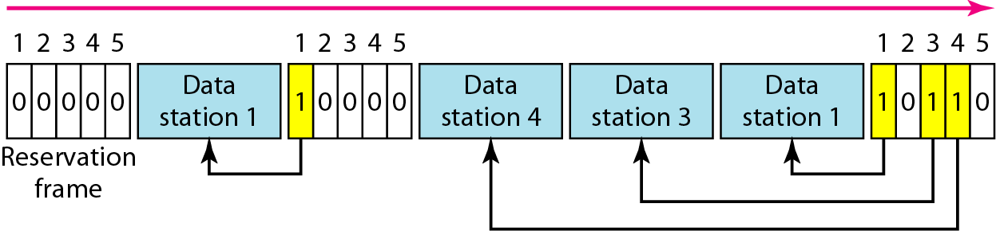
Figure.18 Reservation access method

Slide 5
Figure.18 shows a situation with five stations and a five-mini slot reservation frame.
In the first interval, only stations 1, 3, and 4 have made reservations.
In the second interval, only station 1 has made a reservation.

Slide 6
Polling :
Polling works with topologies in which one device is designated as a primary station and the other devices are secondary stations.
All data exchanges must be made through the primary device even when the ultimate destination is a secondary device.
The primary device controls the link; the secondary devices follow its instructions.
It is up to the primary device to determine which device is allowed to use the channel at a given time.
The primary device, therefore, is always the initiator of a session (see Figure 19).

Slide 7
If the primary wants to receive data, it asks the secondaries if they have anything to send; this is called poll function.
If the primary wants to send data, it tells the secondary to get ready to receive; this is called select function.
So the primary must alert the secondary to the upcoming transmission and wait for an acknowledgment of the secondary's ready status.
Before sending data, the primary creates and transmits a select (SEL) frame, one field of which includes the address of the intended secondary.
When the primary is ready to receive data, it must ask (poll) each
device in turn if it has anything to send.
When the first secondary is approached, it responds either with a NAK frame if it has nothing to send or with data if it does.
When the response is positive (a data frame), the primary reads the frame and returns an acknowledgment (ACK frame), verifying its receipt.

Slide 8
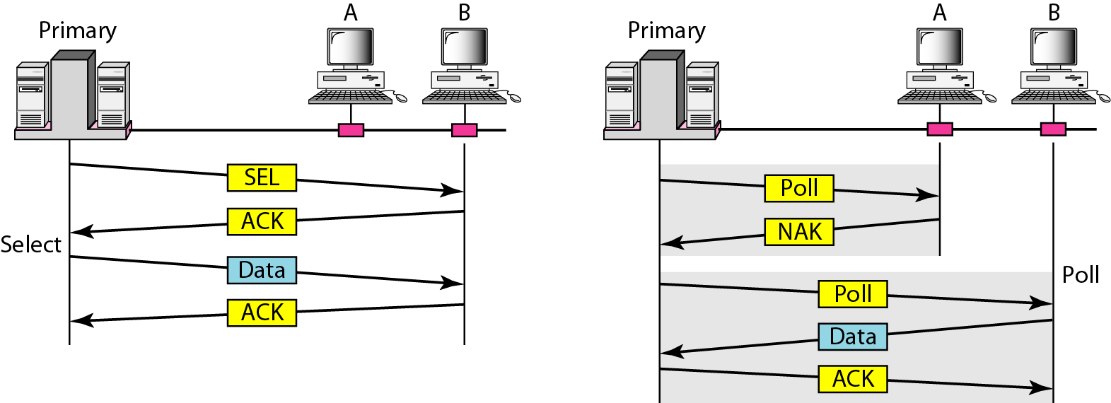
Figure.19 Select and poll functions in polling access method

Slide 9
Token Passing :
In the token-passing method, the stations in a network are organized in a logical ring.
In other words, for each station, there is a predecessor and a successor.
The current station is the one that is accessing the channel now.
The right to this access has been passed from the predecessor to the current station.
The right will be passed to the successor when the current station has no more data to send.

Slide 10
In this method, a special packet called a token circulates through the ring.
The possession of the token gives the station the right to access the channel and send its data.
When a station has some data to send, it waits until it receives the token from its predecessor.
It then holds the token and sends its data.
When the station has no more data to send, it releases the token, passing it to the next logical station in the ring.
The station cannot send data until it receives the token again in the next round.
In this process, when a station receives the token and has no data to send, it just passes the data to the next station.

Slide 11
Token management is needed for this access method.
Stations must be limited in the time they can have possession of the token.
The token must be monitored to ensure it has not been lost or destroyed. For example, if a station that is holding the token fails, the token will disappear from the network.
Another function of token management is to assign priorities to the stations and to the types of data being transmitted.
And finally, token management is needed to make low-priority stations release the token to high-priority stations.

Slide 12
Logical Ring :
In a token-passing network, stations do not have to be physically connected in a ring; the ring can be a logical one.
Figure.20 show four different physical topologies that
can create a logical ring.
In the physical ring topology, when a station sends the token to its successor, the token cannot be seen by other stations; the successor is the next one in line.
The problem with this topology is that if one of the links-the medium between two adjacent stations fails, the whole system fails.

Slide 13
The dual ring topology uses a second (auxiliary) ring which operates in the reverse direction compared with the main ring.
If one of the links in the main ring fails, the system automatically combines the two rings to form a temporary ring.
After the failed link is restored, the auxiliary ring becomes idle again.
This topology to work, each station needs to have two transmitter ports and two receiver ports.
In the bus ring topology, also called a token bus, the stations are connected to a single cable called a bus.
They, however, make a logical ring, because each station knows the address of its successor (and also predecessor for token management purposes).
When a station has finished sending its data, it releases the token and inserts the address of its successor in the token.

Slide 14
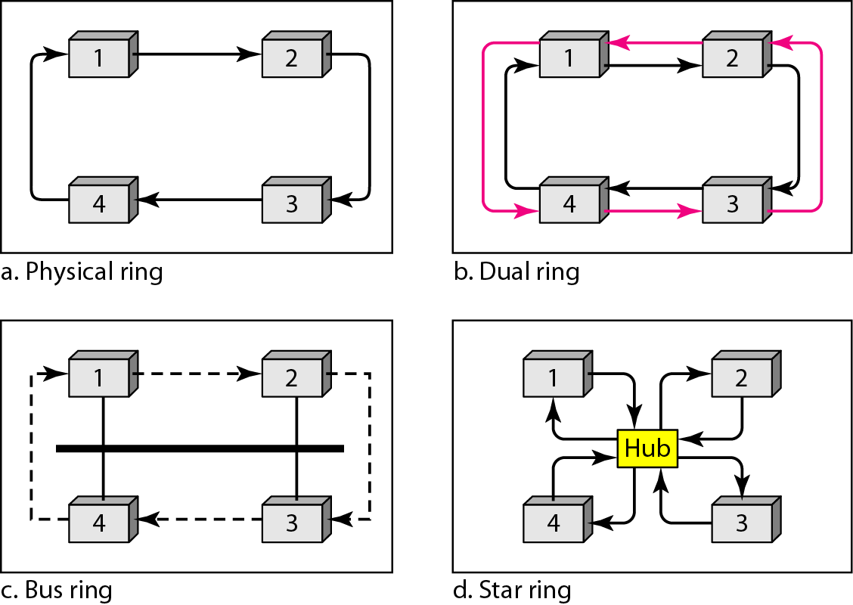
Figure.20 Logical ring and physical topology in token-passing access method

Slide 15
Only the station with the address matching the destination address of the token gets the token to access the shared media.
The Token Bus LAN, standardized by IEEE, uses this topology.
In a star ring topology, the physical topology is a star.
There is a hub, however, that acts as the connector. The wiring inside the hub makes the ring; the stations are connected to this ring through the two wire connections.
This topology makes the network less prone to failure because if a link goes down, it will be bypassed by the hub and the rest of the stations can operate.
Also adding and removing stations from the ring is easier.
This topology is still used in the Token Ring LAN designed by IBM.

Slide 16
CHANNELIZATION
Channelization is a multiple-access method in which the available bandwidth of a link is shared in time, frequency, or through code, between different stations. In this section, we discuss three channelization protocols.
Topics discussed in this section:
Frequency-Division Multiple Access (FDMA) Time-Division Multiple Access (TDMA)
Code-Division Multiple Access (CDMA)

Slide 17
Frequency-Division Multiple Access (FDMA) :
In frequency-division multiple access (FDMA), the available bandwidth is divided into frequency bands.
Each station is allocated a band to send its data. In other words, each band is reserved for a specific station, and it belongs to the station all the time.
Each station also uses a bandpass filter to confine the transmitter frequencies.
To prevent station interferences, the allocated bands are separated from one another by small guard bands. Figure.21 shows the idea of FDMA.

Slide 18
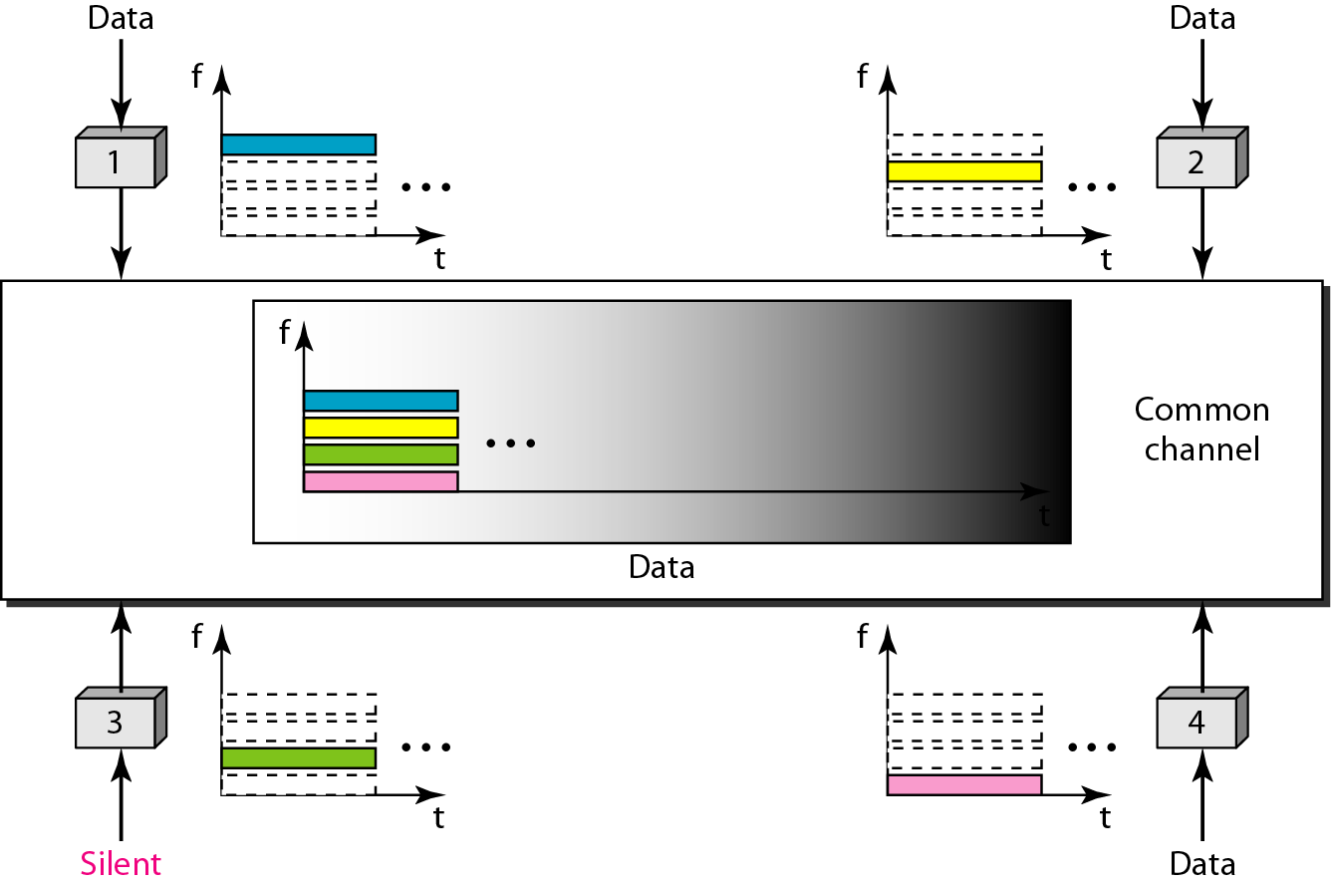
Figure.21 Frequency-division multiple access (FDMA)

Slide 19
FDMA specifies a predetermined frequency band for the entire period of communication.
FDMA and FDM conceptually seem similar, but there are differences between them.
FDM, is a physical layer technique that combines the loads from low-bandwidth channels and transmits them by using a high-bandwidth channel. The channels that are combined are low-pass.
FDMA, on the other hand, is an access method in the data link layer.

Slide 20

Note
In FDMA, the available bandwidth of the common channel is divided into bands that are separated by guard bands.

Slide 21
Time-Division Multiple Access (TDMA) :
In time-division multiple access (TDMA), the stations share the bandwidth of the channel in time.
Each station is allocated a time slot during which it can send data.
Each station transmits its data in is assigned time slot. Figure.22 shows the idea behind TDMA.
The main problem with TDMA lies in achieving synchronization between the different stations.
Each station needs to know the beginning of its slot and the location of its slot.
This may be difficult because of propagation delays introduced in the system if the stations are spread over a large area.

Slide 22
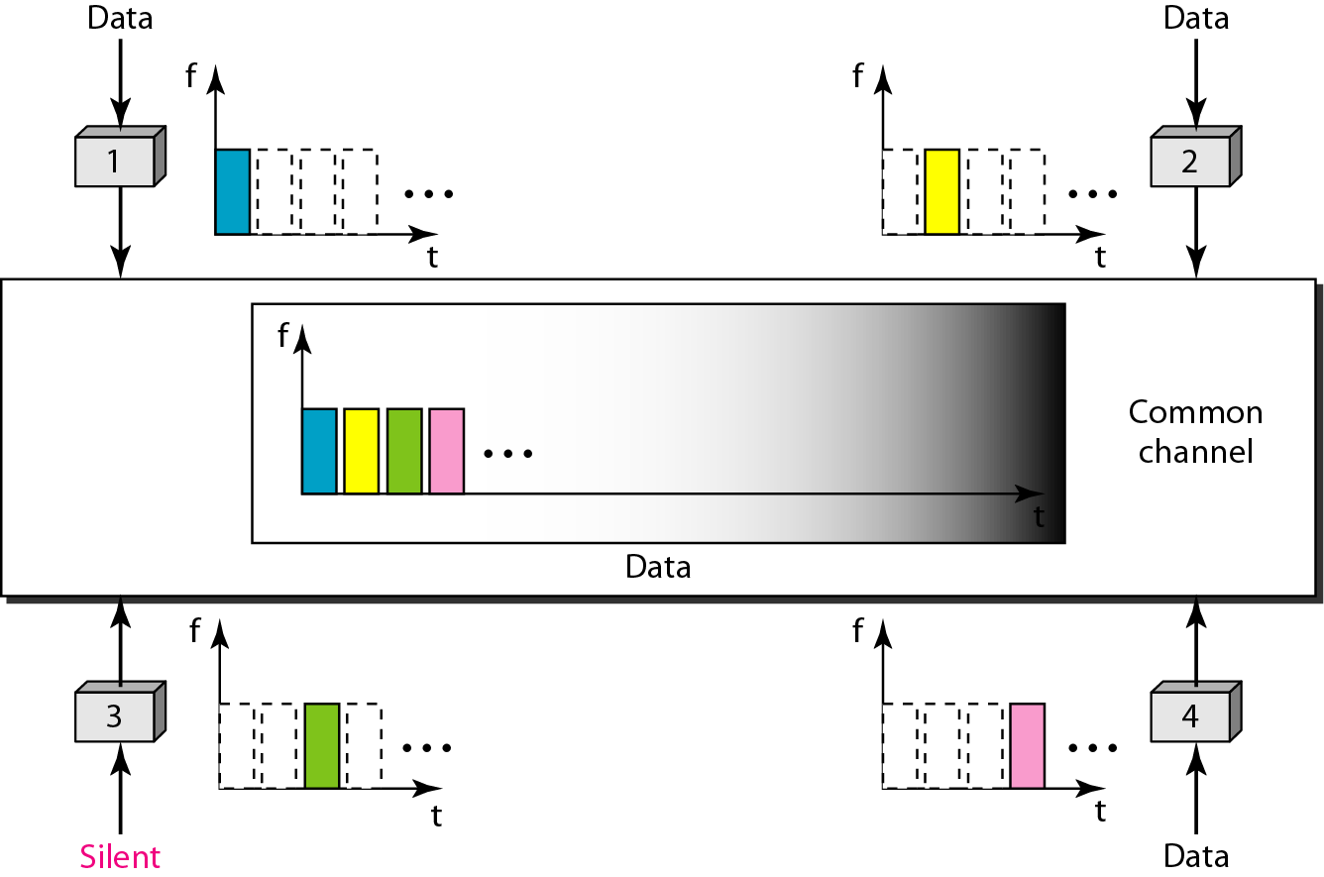
Figure 12.22 Time-division multiple access (TDMA)

Slide 23
To compensate for the delays, we can insert guard times.
Synchronization is normally accomplished by having some synchronization bits (normally referred to as preamble bits) at the beginning of each slot.
TDMA and TDM conceptually seem the same, there are differences between them.
TDM, is a physical layer technique that combines the data from slower channels and transmits them by using a faster channel.
TDMA, on the other hand, is an access method in the data link layer.

Slide 24
Note
In TDMA, the bandwidth is just one channel that is timeshared between different stations.

Slide 25
Note
In CDMA, one channel carries all transmissions simultaneously.

Slide 26
Code-Division Multiple Access (CDMA) :
CDMA differs from FDMA because only one channel occupies the entire bandwidth of the link.
It differs from TDMA because all stations can send data simultaneously; there is no timesharing.
CDMA simply means communication with different codes.
For example, in a large room with many people, two people can talk in English if nobody else understands English.
Another two people can talk in Chinese if they are the only ones who understand Chinese, and so on.
In other words, the common channel, the space of the room in this case, can easily allow communication between several couples, but in different languages (codes).

Slide 27
Let us assume we have four stations 1, 2, 3, and 4 connected to the same channel.
The data from station 1 are d 1 , from station 2 are d2, and so on.
The code assigned to the first station is c1, to the second is c2, and so on.
We assume that the assigned codes have two properties.
1. If we multiply each code by another, we get 0.
2. If we multiply each code by itself, we get 4 (the number of stations).
With these two properties in mind, let us see how the above four stations can send data using the same common channel, as shown in Figure.23.

Slide 28
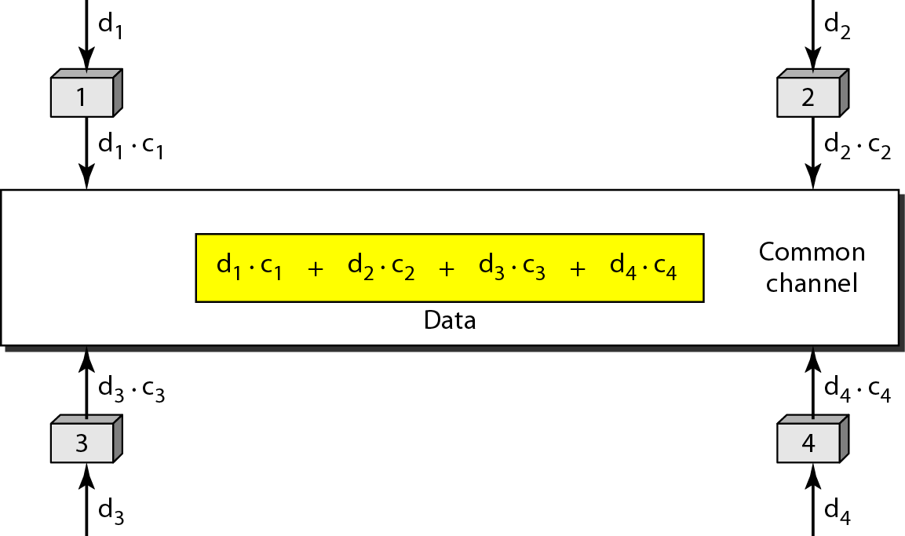
Figure.23 Simple idea of communication with code

Slide 29
Chips :
Each station is assigned a code, which is a sequence of numbers called chips, as shown in Figure.24.
Chip sequences have not chosen randomly, they were carefully selected.
They are called orthogonal sequences and have the following properties:
1. Each sequence is made of N elements, where N is the number of
stations.
2. If we multiply a sequence by a number, every element in the sequence is multiplied by that element. This is called multiplication of a sequence by a scalar. For example, 2. [+1 +1-1-1]=[+2+2-2-2]
3. If we multiply two equal sequences, element by element, and add the results, we get N, where N is the number of elements in the each sequence. This is called the inner product of two equal sequences. For example,
[+1 +1-1 -1] ·[+1 +1 -1 -1] = 1 + 1 + 1 + 1 = 4

Slide 30
Figure.24 Chip sequences

Slide 31
4. If we multiply two different sequences, element by element, and add the results, we get 0. This is called inner product of two different sequences. For example, [+1 +1 -1 -1] • [+1 +1 +1 +1] = 1 + 1 - 1 - 1 = 0
5. Adding two sequences means adding the corresponding elements. The result is another sequence.
For example, [+1 +1 -1 -1]+[+1 +1 +1 +1]=[+2 +2 0 0]

Slide 32
Figure.25 Data representation in CDMA

Slide 33
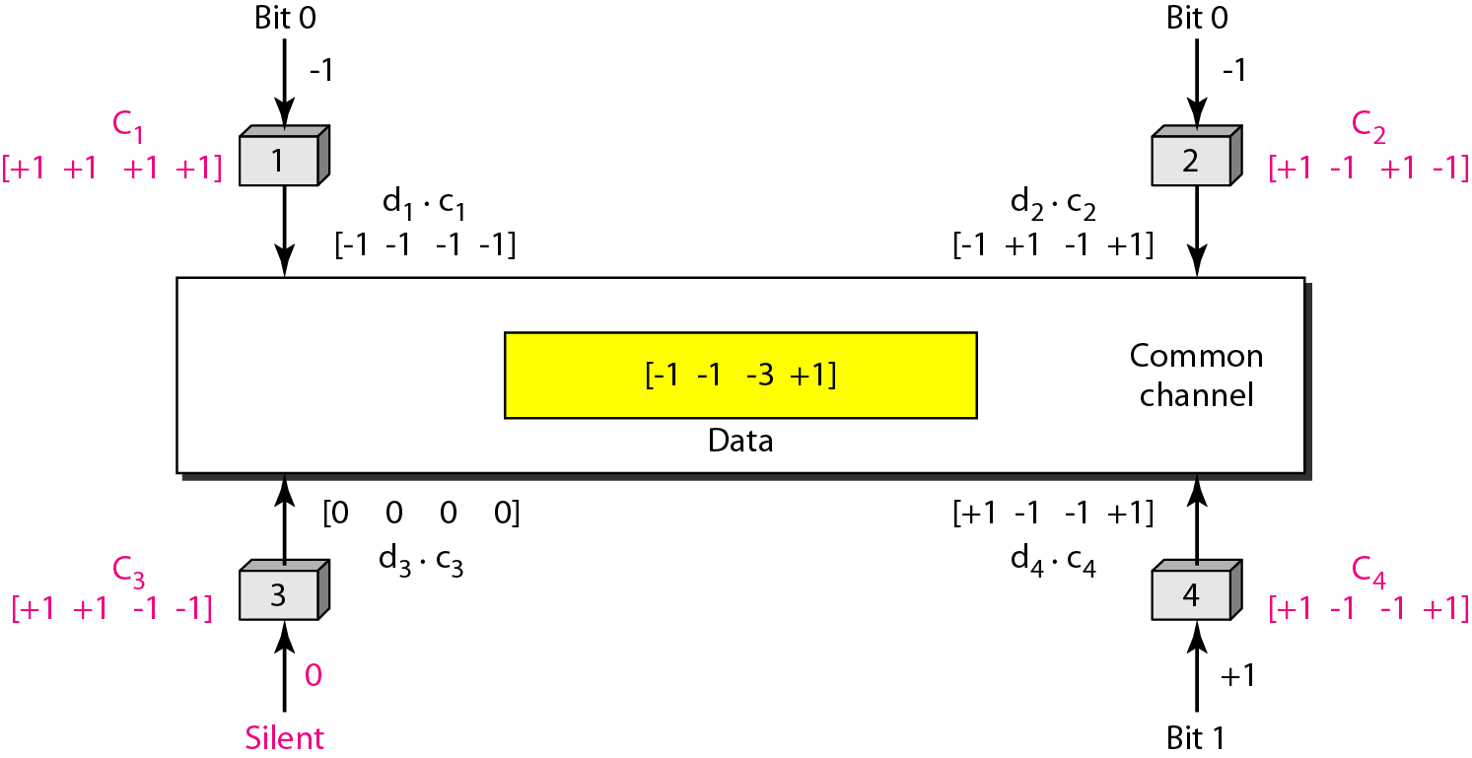
Figure.26 Sharing channel in CDMA

Slide 34
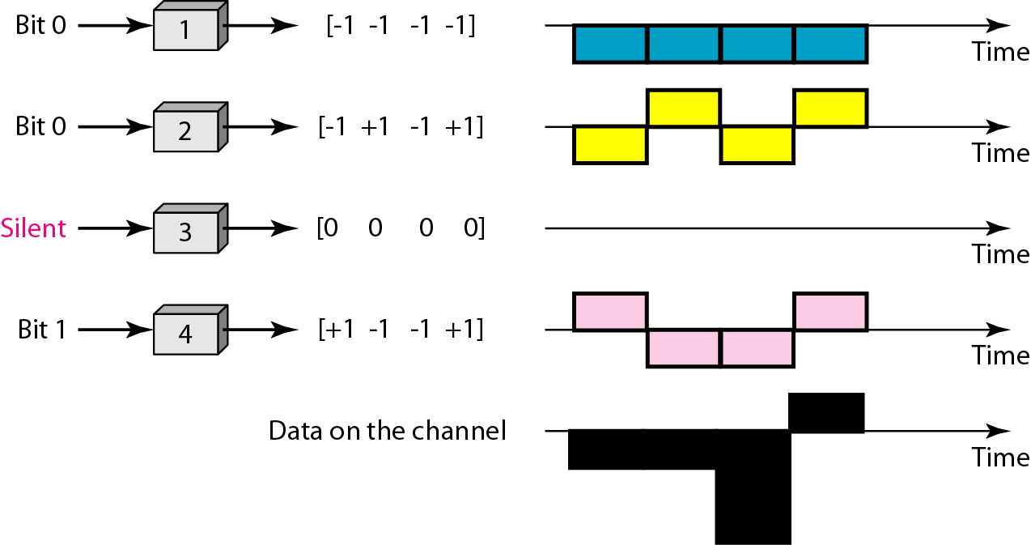
Figure.27 Digital signal created by four stations in CDMA

Slide 35
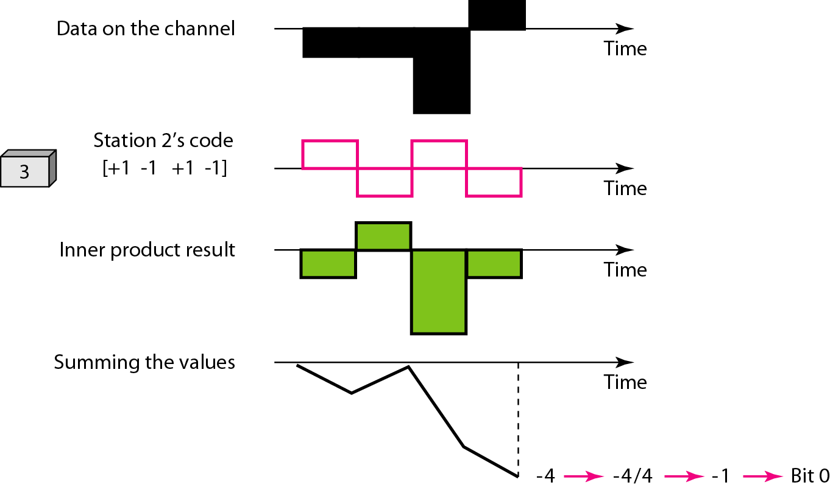
Figure.28 Decoding of the composite signal for one in CDMA

Slide 36
Sequence Generation :
To generate chip sequences, we use a Walsh table, which is a two-dimensional table with an equal number of rows and columns, as shown in Figure.29.
In the Walsh table, each row is a sequence of chips. W1 for a one-chip sequence has one row and one column. We can choose –1 or +1 for the chip for this trivial table (we chose +1).
According to Walsh, if we know the table for N sequences WN, we can create the table for 2N sequences W2N, as shown in Figure.29.
The WN with the overbar WN stands for the complement of WN where each +1 is changed to -1 and vice versa.
Figure.29 also shows how we can create W2 and W4 from W1.

Slide 37
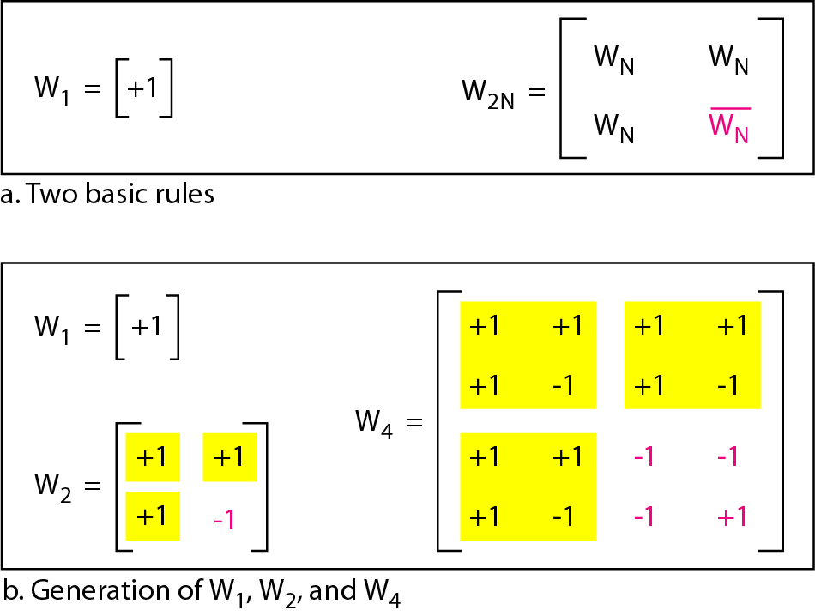
Figure.29 General rule and examples of creating Walsh tables

Slide 38
After W2 is generated, W4 can be made of four W2's, with the last one the complement of W2.
Of course, W8 is composed of four W4's, and so on. Note that after WN is made, each station is assigned a chip corresponding to a row.
Something we need to emphasize is that the number of sequences N needs to be a power of 2. In other words, we need to have N = 2m.

Slide 39
Note
The number of sequences in a Walsh table needs to be N = 2^{m}.

Slide 40
IEEE 802.11 MAC Protocol: CSMA/CA
802.11 sender
1 if sense channel idle for DIFS then
transmit entire frame (no CD)
2 if sense channel busy then
start random backoff time
timer counts down while channel idle
transmit when timer expires
if no ACK, increase random backoff interval, repeat 2
802.11 receiver
- if frame received OK
return ACK after SIFS (ACK needed due to hidden terminal problem)
sender
receiver
DIFS
data
SIFS
ACK

Slide 41
Avoiding collisions (more)
idea: allow sender to “reserve” channel rather than random access of data frames: avoid collisions of long data frames
sender first transmits small request-to-send (RTS) packets to BS using CSMA
RTSs may still collide with each other (but they’re short)
BS broadcasts clear-to-send CTS in response to RTS
CTS heard by all nodes
sender transmits data frame
other stations defer transmissions
avoid data frame collisions completely
using small reservation packets!

Slide 42



Collision Avoidance: RTS-CTS exchange
A
B
AP
RTS(B)
RTS(A)
reservation collision
RTS(A)
CTS(A)
CTS(A)
DATA (A)
defer
time
ACK(A)
ACK(A)

Slide 43
802.11 frame: addressing
2
2
6
6
6
2
6
0 - 2312
4
frame
control
duration
address
1
address
2
address
3
seq
control
address
4
payload
CRC
Address 4: used only in ad hoc mode
Address 1: MAC address
of wireless host or AP
to receive this frame
Address 3: MAC address
of router interface to which AP is attached
Address 2: MAC address
of wireless host or AP
transmitting this frame

Slide 44
802.11 frame: addressing
Internet
H1
R1
router
R1 MAC addr H1 MAC addr
dest. address
source address
802.3 frame
AP MAC addr H1 MAC addr R1 MAC addr
address 1
address 2
address 3
802.11 frame

Slide 45
802.11 frame: more
frame seq #
(for RDT)
duration of reserved
transmission time (RTS/CTS)
2
2
6
6
6
2
6
0 - 2312
4
frame
control
duration
address
1
address
2
address
3
seq
control
address
4
payload
CRC
2
2
4
1
1
1
1
1
1
1
1
Protocol
version
Type
Subtype
To
AP
From
AP
More
frag
Retry
Power
mgt
More
data
WEP
Rsvd
frame type
(RTS, CTS, ACK, data)

